Slide 1
ChronoNet
By: Matt Baker, Parker Spires, Jason Fantl, Jarek Brown, and Jacob Hendricks

Slide 2
Introduction
ChronoNet is a social media site with a new twist.
Our goal was to make a social networking platform which offers something different.
Each post is created with a timer. Once that timer reaches 0, the post is removed.

Slide 3
How Time Works
Liking a post will increase the time left.
Disliking a post will decrease the time left.
The amount of time that a like and dislike effect the post slowly decreases in a non-linear way.

Slide 4

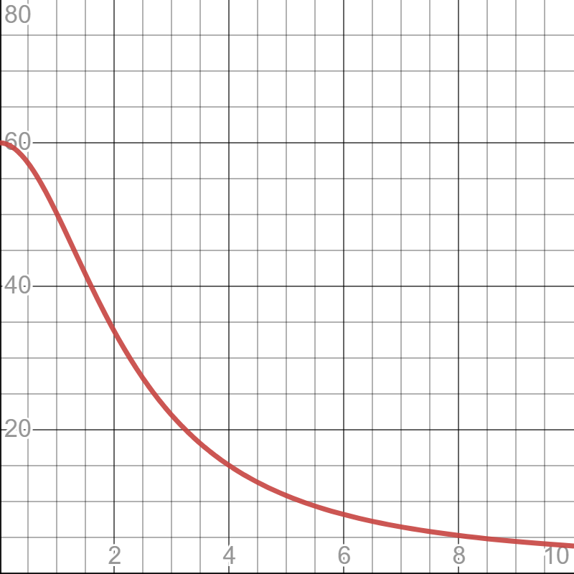

Time Function
X-axis = time elapsed
Y-axis = Effect of like/dislike
Formula: $\frac{r_max−r_min}{1−\frac{x^{2}}{t_decay}}+r_min$

Slide 5
Posts
The content of the post can be written in plain text. Markdown is also supported.
The time the post was created, as well as the remaining time on the posts is visible for everyone to see.
A logged in user will also have the option to like or dislike a post.

Slide 6
Features
Account creation deletion
Following
Personalized Feed
Profile editing
Hovering
Markdown
Post timer

Slide 7
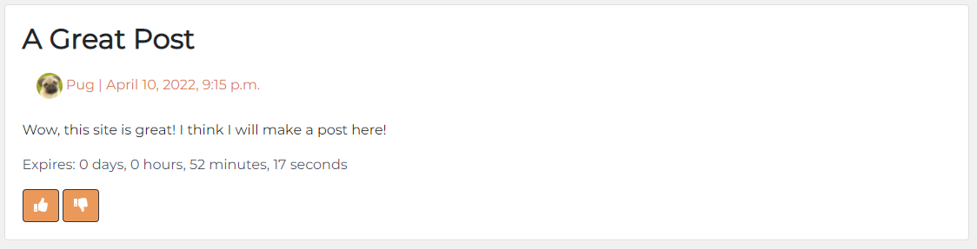
Post Design

Slide 8
Front end Design
We designed our front end to be easy to access.
The posts are all located in the center of the screen so they can be easily seen.
The top of the page allows users to login, register, and switch between the different pages of the site.

Slide 9
Front End
(Add graphic here once everything is finalized)

Slide 10
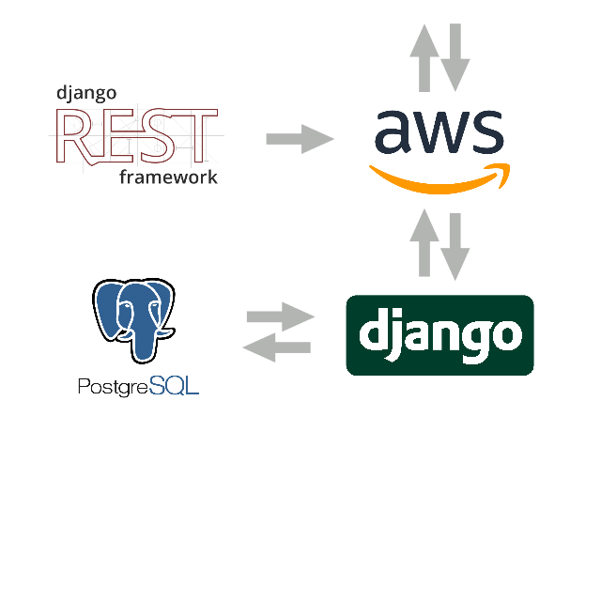
Tech Stack
Django
Python
HTML/CSS
GPT-2
REST
PostgreSQL
AWS
Apache

Slide 11

Security
Passwords are secure – PBKDF2 with a SHA256 hash
Password requirements when registering an account
HTTPS is strictly enforced – redirects and HSTS headers
The connection to the site is encrypted – TLS 1.3 and AES-128
Input sanitization and validation
For login fields and post creation fields

Slide 12
Security Cont.
Admin honeypot for the default admin endpoint
Actual endpoint relocated
Cross Site Request Forgery protections (CSRF token)
Valid host/domain explicitly specified

Slide 13
Bots
We wanted to give the platform a real feeling.
The bots use GPT-2 to generate posts through the API.
Each bot starts with three entirely random posts. Any other posts are made from a baseline of the three original posts.
This way, each bot has their own personality.

Slide 14
Bots
(Add flow chart here)

Slide 15
Future Implementations
Once we have real users on the platform, we can add a more sophisticated post ordering and recommendations.
We also have the option of adding more social features such as comments and direct messages.

Slide 16

DEMO
Website: https://khrono.space/

